Slide 1
LiDAR-Based Environmental Object Classification System
Client: Ahmed Nazar
Advisor: Dr. Mohamed Y. Selim
Team Members: Ella Rekow, Sachin Patel, Zachary Schmalz, Anuraag Pujari, Ryan Sand, Daniel Rosenhamer

Slide 2
Problem Statement
There is a lack of 3D LiDAR object classification models that work with multiple LiDAR data formats, are scalable in terms of the data size, number of object classes, and the ease of adding features, and are efficient in real-time applications.

Slide 3
Objective
Create an open-source labeled LiDAR dataset
Create an object classification machine learning model
Train model with the labeled dataset
Ensure scalability of model
Allows for more objects classes and data features
Notes:
Mentioned use cases on this slide

Slide 4
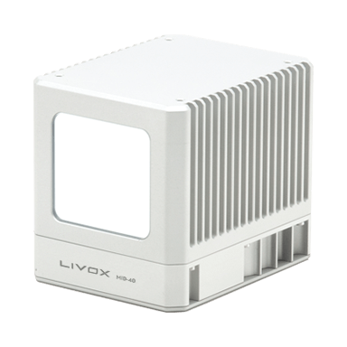
LiDAR Specifications
LiDAR → Light Detection and Ranging
Livox Mid-40
Cost effective
Point Cloud Format
Typically .ply or .las
.lvx → unique to Livox Products
[1] Livox Mid-40
Livox Viewer Frame
Our Data
Only used with Livox’s tool
Incompatible with more efficient training models
Webcam Frame
Notes:
Spoken point --> we didn't pay for this
Explicitly state we took our own data

Slide 5
Engineering Standards
ISO/IEC 20889:2018 - Preserve personally identifiable information
IEEE 1588-2008 - Synchronize clocks between LiDAR and camera
IEEE 1451 family of standards - Standard for exchanging data between systems
Notes:
Very fast slide

Slide 6
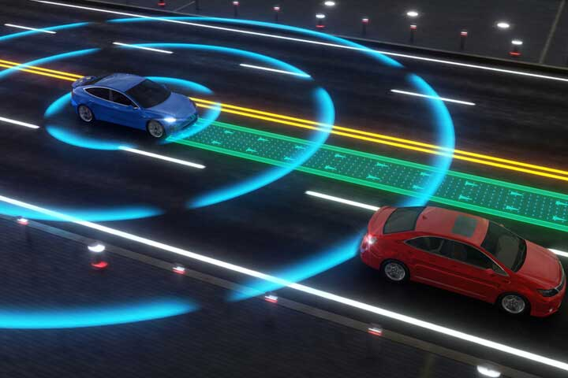
Use Cases
Robotics
Path finding
Autonomous Vehicles
Honda Legend [5]
Mercedes-Benz Class S [5]
Population monitoring
Classroom Group attendance
Forestry application
[4] Visual model of an autonomous vehicle detecting its surroundings
Notes:
Mentioned use cases on this slide

Slide 7
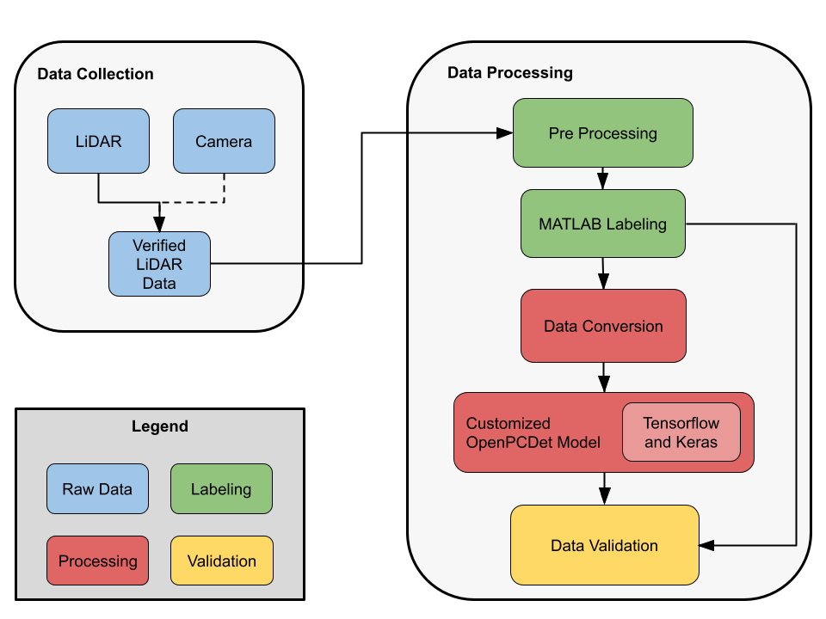
Process Overview
Notes:
Data collection
Data team
Label collected data in MATLAB
Modify data to be match format of Kitti data
Model team
Run OpenPCDet with Kitti data
Run collected data on model

Slide 8
Labeling and Processing Data
Labeling Tool
MATLAB Lidar Labeler
Point Cloud Temporal Interpolator
Data Preprocessing
Convert MATLAB labels to CSV
Parse CSV into label text files
Split labels into training and testing
LiDAR labels alongside camera feed

Slide 9
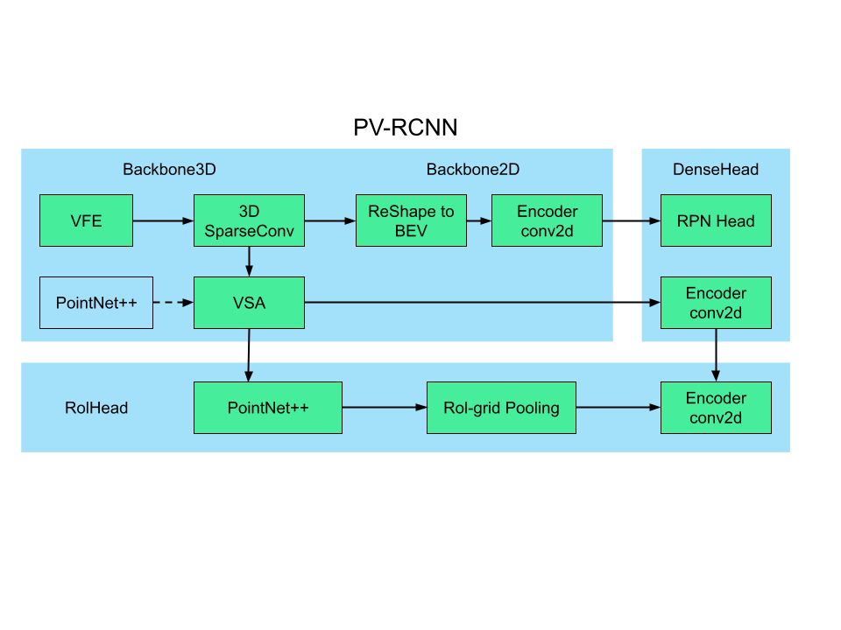
Model
OpenPCDet
LiDAR Specifically
Framework to run
11 various models
Takes pre-trained data and custom data
[3] OpenPCDet PV-RCNN model structure
Notes:
Have basic information on screen, but explain a bit more when presenting.
OpenPCDet is a framework for running Lidar Object classification
It can work with 11 cutting edge different models
How it works

Slide 10
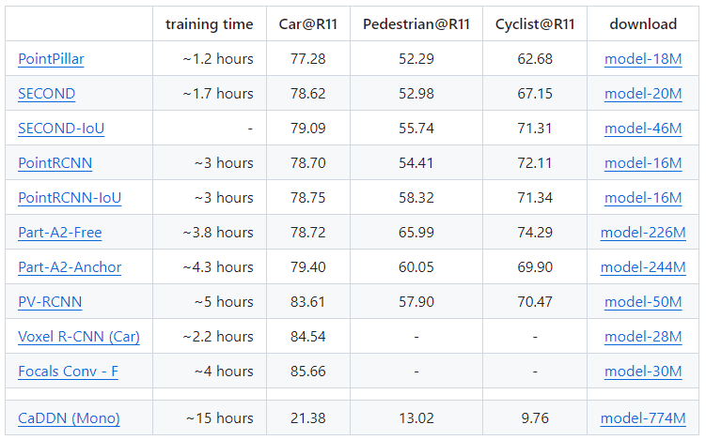
Model
Each Model’s Training
KITTI Data
8 GTX 1080 Ti
[3] KITTI 3D Object Detection Baselines
Notes:
Point-Voxel Region-based Convolutional Neural Network (PV-CNN)
Relatively high computation time
Strong estimations
Worth the trade off
Various models and their training times. Each of these are using the same dataset we used, KITTI and 8 GTX 1080 Ti GPUs
Karlsruhe Institute of Technology and Toyota Technological Institute

Slide 11
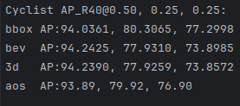
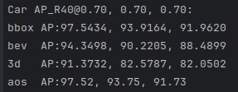
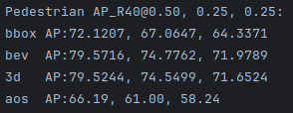
Initial Results
Output of running pv_rcnn model on the KITTI dataset using OpenPCDet with 100 epochs and batch size of 1.
Evaluation log output with performance of different detection methods.
Visualization of bounding boxes made by trained model.
Notes:
IoU (intersection over union) is a measure of overlap between two bounding box; detection and ground truth boxes. IoU for bbox, bev, and 3d
BBOX is used for evaluating the 2D object detection after projecting the 3D bounding boxes to the image, 3D is used for evaluating the 3D bounding boxes. BEV is used to evaluate the predictions using bird’s eye view approach. Average orientation similarity (AOS) takes into account the orientation of the predicted boxes
3 columns: easy medium and hard
Each IoU threshold applies to different difficulty levels easy, medium and hard consecutively. The reason for this is that objects in hard category are more difficult to detect than objects in easy category.
difficulty levels are determined while dataset is labelled, therefore, they might not be suitable for every datasets available
AP@0.70, 0.70, 0.70 refers to the average precision (AP) for 2D detection (bbox), bird-view detection (bev) and 3D detection (3d), where IOU>0.70 would be considered as positive samples. In comparison, AP@0.70, 0.50, 0.50 refers to the IOU thresholds are 0.70 for bbox, 0.50 for bev and 0.50 for 3d. So you can find that bbox results in these two groups are the same, while the bev and 3d results are better in the results below with less strict metrics.
AOS means average orientation similarity. It seems that there exist some problems in terms of orientation estimation in evaluation of 3DSSD. @encore-zhou Please have a look at of this result.
You can mainly focus on the 3D detection precision, which is the main result for this task.
https://github.com/open-mmlab/mmdetection3d/issues/185

Slide 12
Testing and Final Results
What needs to be tested:
OpenPCDet setup
Correct preprocessing formats
Use 80% of data for training
20% of data for testing
>75% accuracy compared to ground truth data
[2] ML-Based System Testing and Monitoring
Notes:
We need to fit this in to satisfy these class requirements:
Professional responsibility - an ability to recognize ethical and professional responsibilities in engineering situations and make informed judgments, which must consider the impact of engineering solutions in global, economic, environmental, and societal contexts
Testing and analysis - an ability to develop and conduct appropriate experimentation, analyze and interpret data, and use engineering judgment to conclude
Mention labels as testing

Slide 13
Challenges
Prerequisites for OpenPCDet
Specific dependency versions
Reliant on powerful hardware
Difficulty finding useful documentation
Provided documentation was inconsistent or incorrect
Minimal community support and communication
Correctly preprocessing and labeling data
Specific file formats are required
Automatic labeling tools were incompatible with our data
Notes:
Established datasets didn’t elaborate Talk about how labeling can be difficult for LiDAR vs camera labelling
Difficulty finding accurate ground truth methods
Established datasets didn’t elaborate
Fully automatic methods were not compatible

Slide 14
Completed Objectives
Created a labeled LiDAR dataset of Livox data
Created conversion for labels to be used by the model
Object classification machine learning model
Ensure scalability of model
Allows for more objects classes and data features
Notes:
Expanded upon the OpenPCDet framework to create a custom training model

Slide 15
Future Work
Data processing
Train model with custom lidar labeled dataset
Model modifications
Improve the model from results
.lvx Support
Testing
Ensure model accurately labels
Notes:
Take our labeled dataset and get the OpenPCDet PV-RCNN model running. Once the model has trained on our Livox data, use the results to reconfigure the model to improve confidences and reduce runtimes.

Slide 16
References
[1] “Mid-40 lidar sensor - Livox,” Livoxtech.com. [Online]. Available: https://www.livoxtech.com/mid-40-and-mid-100
[2] E. Breck, S. Cai, E. Nielsen, M. Salib, and D. Sculley, “The ML test score: A rubric for ML production readiness and technical debt reduction,” in 2017 IEEE International Conference on Big Data (Big Data), 2017
[3] OpenPCDet: OpenPCDet Toolbox for LiDAR-based 3D Object Detection
[4] A. J. Princy, “Automotive LiDAR sensor: A 360-degree vision eye for autonomous cars,” Research Dive, 13-Apr-2020. [Online]. Available: https://www.researchdive.com/blog/Automotive-LiDAR-Sensor-A-360-Degree-Vision-Eye-for-Autonomous-Cars
[5] “Valeo SCALATM LiDAR,” Valeo, 25-Jan-2022. [Online]. Available: https://www.valeo.com/en/valeo-scala-lidar/

Slide 17
Questions?

